Slide 1
Approximation Algorithms
Analysis of Algorithms

Slide 2
Motivation: Getting around NP-completeness
Exponential time may be acceptable for small inputs [Brute Force]
Isolate special cases that can run in polynomial time [Divide-and-Conquer]
Near-optimal solutions may be acceptable [Approximation Algorithms]

Slide 3
Performance Ratios
C* is the cost of the optimal solution
C is the cost of the solution produced by an approximation algorithm
An algorithm has an approximation ratio of ρ(n) if for an input of size n, C is within a factor of C*

Slide 4
Performance Ratios [cont.]
Maximization problem
  0 < C <= C*
  C* / C factor by which the cost of the optimal solution is larger than the cost of the approximate solution
Minimization problem
  0 < C* <= C
  C / C* factor by which the cost of the approximate solution is larger than the cost of the optimal solution

Slide 5
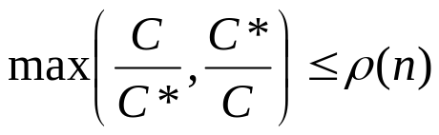
Definitions
Approximation Algorithm
  produces “near-optimal” solution
Algorithm has approximation ratio ρ(n) if:
Approximation Scheme
  (1+ε)-approximation algorithm for fixed ε
    ε > 0 is an input
  Polynomial-Time Approximation Scheme
    time is polynomial in n
C = cost of algorithm’s solution
C* = cost of optimal solution
n = number of inputs = size of instance

Slide 6
How do approximations algorithms work?
Exploit the nature of the problem
Use greedy techniques
Use linear programming
Use dynamic programming
Use random assignments

Slide 7
Overview
VERTEX-COVER
  Polynomial-time 2-approximation algorithm
TSP
  TSP with triangle inequality
    Polynomial-time 2-approximation algorithm
  TSP without triangle inequality
    Negative result on polynomial-time ρ(n)-approximation algorithm
SET-COVER
    polynomial-time ρ(n)-approximation algorithm
      ρ(n) is a logarithmic function of set size
SUBSET-SUM
  Fully polynomial-time approximation scheme
MAX-3-CNF Satisfiability
  Randomized ρ(n)-approximation algorithm

Slide 8
The vertex-cover problem
Let G=(V,E) be an undirected graph
A vertex cover
  subset V’ of V
  such that if (u,v) is an edge of G, then either u belongs in V’ or v belongs in V’ (or both)
The size of a vertex cover is the number of vertices in it

Slide 9
The vertex-cover problem [cont.]
The vertex-cover problem is to find a vertex cover of minimum size
Such a vertex-cover is called an optimal vertex cover
This problem is NP-complete

Slide 10
Consider the graph:
b
c
d
a
e
f
g
By inspection, optimal vertex cover is {b,d,e}
C* = size of optimal solution = 3

Slide 11
Approx-Vertex-Cover (G)
C ← NULL //C contains results of vertex cover
E’ ← E[G] //Initially all edges are stored here
while E’ != NULL //all edges that are not considered yet
do let (u,v) be an edge of E’ //select an edge from E’
C ← C U {u,v} //add vertices to C of the selected edge
remove from E’ all edges incident on u or v
//delete all edges related to the vertices “u” and “v”
return C

Slide 12
Back to our graph:
b
c
d
a
e
f
g
C :
a b
c d
e f
Approximate vertex cover. C=6
E’ :
(a,b)
(b,c)
(c,d)
(c,e)
(d,e)
(d,f)
(d,g)
(e,f)

Slide 13
Improved version:
b
c
d
a
e
f
g
C :
d e b c
Approximate vertex cover. C=4
E’ :
(d,e)
(c,d)
(c,e)
(d,f)
(d,g)
(e,f)
(b,c)
(a,b)

Slide 14
Is it possible to approximate the optimal solution?
b
c
d
a
e
f
g
In this case, and with our algorithm, NO!

Slide 15
Analysis of Algorithm
Running time:
  O(V+E): if we use adjacency list.
2-Approximation Algorithm
  Minimization problem C* = 3; C = 6
  Factor = C/C* = 2
Notes:
Problem: Why O(V+E)

Slide 16
Theorem: APPROX-VERTEX-COVER is a polynomial-time 2-approximation algorithm
Proof:
  Polynomial time algorithm because : Complexity = O(V+E)
  Let, A = set of edges picked by approximation algorithm
  No 2 edges in A share an endpoint.
  Thus no 2 edges in A are covered by the same vertex in C*
  So, Lower bound: |C*| >= |A|
  We pick an edge for which neither of its endpoints are already in C
  So, Upper bound: |C| = 2|A|
  Therefore: |C| = 2|A| <= 2|C*|
Notes:
Problem: Can’t understand

Slide 17
Traveling Salesman
TSP with triangle inequality
    Polynomial-time 2-approximation algorithm
  TSP without triangle inequality
    Negative result on polynomial-time ρ(n)-approximation algorithm

Slide 18
The traveling-salesperson problem.
Given a complete undirected graph G=(V,E)
Each edge has a nonnegative integer cost c(u,v)
Find a Hamiltonian cycle of G with minimum cost.
This is a NP complete problem

Slide 19
Triangle Inequality
The cost function satisfies the triangle inequality for all vertices u, v, w in V
  c(u,w) <= c(u,v) + c(v,w)

Slide 20
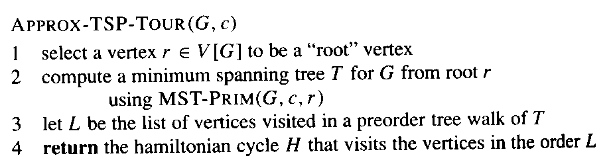
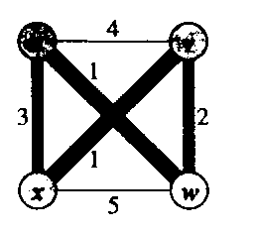
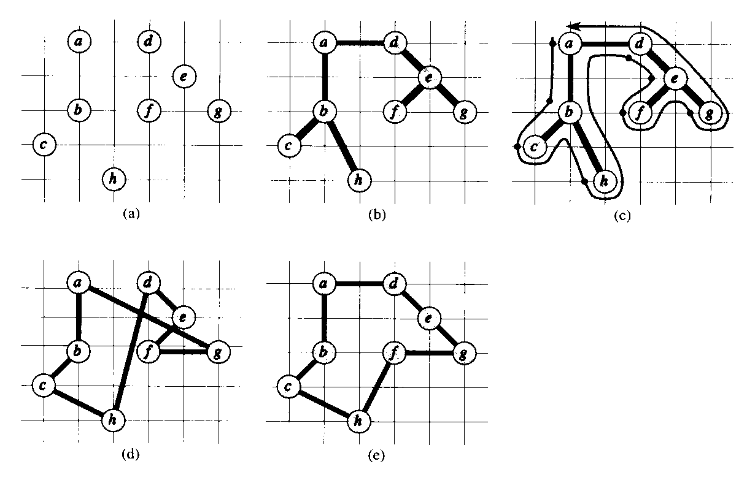
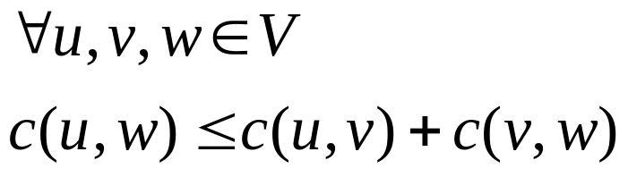
TSP with Triangle Inequality
u
v
5
3
3
5
x
w
4
Cost Function Satisfies
“full walk” = abcbhbadefegeda
Triangle Inequality
final approximate tour
optimal tour
source: 91.503 textbook Cormen et al.

Slide 21
TSP with Triangle Inequality
Time Complexity:
  MST-Prim()’s running time: O(V²)
  So, APPROX-TSP-TOUR’s running time: O(V²)

Slide 22





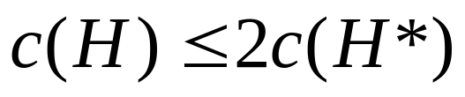
TSP with Triangle Inequality
Theorem: APPROX-TSP-TOUR is a polynomial-time 2-approximation algorithm for TSP with triangle inequality.
Proof:
Algorithm runs in time polynomial in n.
(since deleting 1 edge from a tour creates a spanning tree)
(lists vertices when they are first visited and when returned to after visiting subtree)
(since full walk traverses each edge of T twice)
Now make W into a tour H using triangle inequality.
(New inequality holds since H is formed by deleting duplicate vertices from W.)

Slide 23
TSP without Triangle Inequality
If P ≠ NP, then for any constant ρ≥1, there is no polynomial time approximation algorithm with approximation ratio ρ for the general traveling-salesman problem
Prove: try yourself

Slide 24



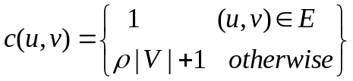
TSP without Triangle Inequality
Theorem: If , then for any constant
polynomial-time approximation algorithm with ratio ρ
for TSP without triangle inequality.
Proof: (by contradiction)
Suppose there is one --- call it A
Showing how to use A to solve NP-complete Hamiltonian Cycle problem contradiction!
Convert instance G of Hamiltonian Cycle into instance of TSP (in polynomial time):
(G’=(V,E’) is complete graph on V)
(assign integer cost to each edge in E’)
For TSP problem (G’,c):
G has Hamiltonian Cycle
(G’,c) contains tour of cost |V|
G does not have Hamiltonian Cycle
Tour of G’ must use some edge not in E
Cost of that tour of G’
Can use A on (G’,c)!
A finds tour of cost at most ρ(length of optimal tour)
G has Hamiltonian Cycle
A finds tour of cost at most ρ|V| cost = |V|
G does not have Hamiltonian Cycle
A finds tour of cost > ρ |V|
If , solving NP-complete hamiltonian cycle in polynomial time is a contradiction!

Slide 25
MAX-3-CNF Satisfiability
3-CNF Satisfiability Background
Randomized Algorithms
Randomized MAX-3-CNF SAT Approximation Algorithm

Slide 26
MAX-3-CNF Satisfiability
Background on Boolean Formula Satisfiability
  Boolean Formula Satisfiability: Instance of language SAT is a boolean formula φ consisting of:
    n boolean variables: x₁, x₂, ... , x_{n}
    m boolean connectives: boolean function with 1 or 2 inputs and 1 output
      e.g. AND, OR, NOT, implication, iff
    parentheses
    truth, satisfying assignments notions apply
NP-Complete
source: 91.503 textbook Cormen et al.

Slide 27
MAX-3-CNF Satisfiability (continued)
Background on 3-CNF-Satisfiability
  Instance of language SAT is a boolean formula φ consisting of:
    literal: variable or its negation
    CNF = conjunctive normal form
      conjunction: AND of clauses
      clause: OR of literal(s)
    3-CNF: each clause has exactly 3 distinct literals
MAX-3-CNF Satisfiability: optimization version of 3-CNF-SAT
- Maximization: satisfy as many clauses as possible
- Input Restrictions:
- exactly 3 literals/clause
- no clause contains both variable and its negation
NP-Complete
source: 91.503 textbook Cormen et al.

Slide 28
Randomized approximation algorithm for MAX-3-CNF-SAT
Each clause has 3 distinct literals. Also assume that no clause contains a variable and its negation.
Problem: Return an assignment of variables which maximizes the number of clauses which evaluate to true.

Slide 29
The random approximation algorithm
Randomly assign a 0 or a 1 value to all variables.

Slide 30
Analysis
We have set each variable to 1 with a ½ probability.
We have set each variable to 0 with a ½ probability.
We define an indicator random variable
  Y_{i} = I {clause i is satisfied}
Y_{i} = 1 as long as at least one of the literals in the i^{th} clause has been set to 1.
A clause is not satisfied iff all it’s literals are 0.
  Pr {clause i is not satisfied} = (½)³ = 1/8

Slide 31
Analysis [cont.]
So Pr {clause i is satisfied} = 1 – 1/8 = 7/8
Lemma 5.1 (CLRS)
  Given a sample space S and an event A in the sample space, let X_{A} = I{A}. Then E[X_{A}] = Pr{A}
E[Y_{i}] = 7/8

Slide 32
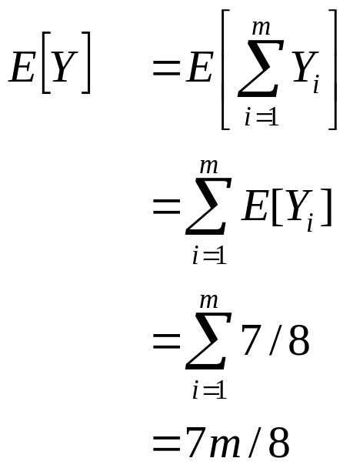
Analysis [cont.]
Let Y = number of satisfied clauses.
  Y = Y₁+Y₂+…..+….. Y_{m}
Then we have:
Since m is the upper bound on the number of satisfied clauses, the approximation ratio is m/(7m/8) = 8/7
Therefore this is a 8/7 approximation algorithm

